Slide 1
How to Reduce Air Pollution Caused by Car Exhaust
EDCI 337 - A01
Yiran Cao

Slide 2
Why do I think this topic is important?

Slide 3
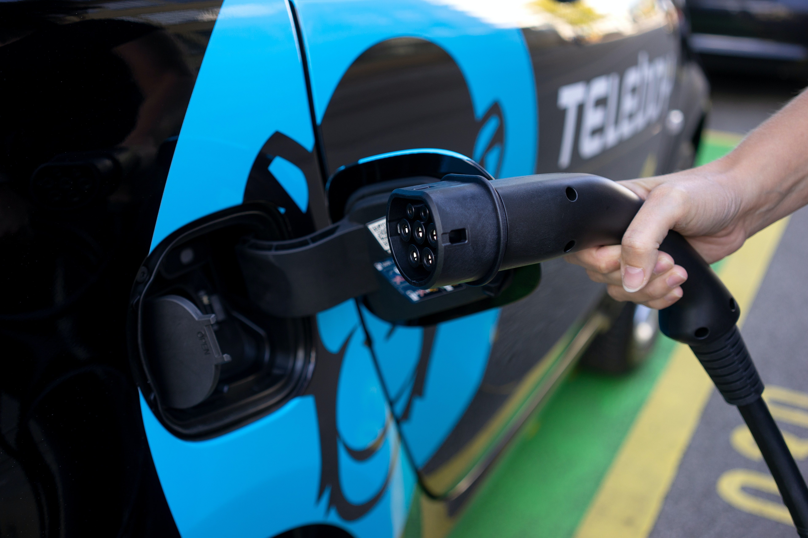
Topic:
Replace Gasoline Cars with Electric Cars
Resource: Photo from Tommy Krombacher on Unsplash

Slide 4
“They found that twice as many deaths can be attributed to these emissions as are caused by accidents, although it is noted that the impact in terms of years of life lost is nevertheless greater for accidents”
- Smith, Axon, & Darton, 2013

Slide 5
Electric Vehicles:
“Ultimately the air-quality challenge will be solved 'at the tailpipe' by vehicle manufacturers and changes in vehicle use”
- Xinhua News Agency, 2020
“[w]ith Canada’s current electric grid, a PEV could reduce emissions by 45–98% compared to a conventional gasoline vehicle”
- Axsen & Long, 2020

Slide 6
Conclusion:
Electric vehicles can reduce the impact of vehicle exhaust emissions on environmental issues.

Slide 7
THANKS FOR WATCHING

Slide 8
References
Axsen, J., & Long, Z. (2020). The Present and Future Market for PEVs in Canada: Evidence from a Mixed-Method Research Program. Who’s Driving Electric Cars Lecture Notes in Mobility, 63-85. doi:10.1007/978-3-030-38382-4_5
Britain to trial lower motorway speed limit to reduce traffic emissions. (2020, September 13). Xinhua News Agency, NA. https://link.gale.com/apps/doc/A635263471/ITBC?u=uvictoria&sid=ITBC&xid=b1165356
Smith, T., Axon, C., & Darton, R. (2013). The impact on human health of car-related air pollution in the UK, 1995–2005. Atmospheric Environment, 77, 260-266. doi:10.1016/j.atmosenv.2013.05.016

